Slide 1
Traffic Flow Prediction using Backpropagation Neural Network
Cycle 3
Himanshu, Vincent, Philip, Donghyeon

Slide 2
Table of Contents
Traffic Flow Prediction
Neural Network
Data Engineering
Neural Network
Management Plan
Lessons Learned

Slide 3
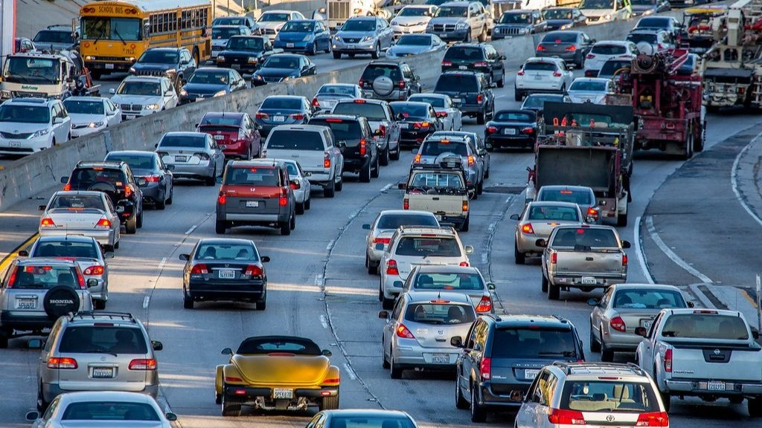
What is Traffic Flow Prediction?
Traffic flow predictions objective is to provide traffic flow information. Timely and accurate traffic flow information can be used to assist in reducing traffic congestion. Traffic congestion affects almost everyone at some point.
Many cities and Department of Transportation’s are starting to consider this problem a critical element to transportation planning. In the context of a city, traffic flow prediction could be used to redirect traffic by adjusting green/red lights around areas that may have higher congestion.
If traffic flow can be predicted, then the traffic flow information will be used to alleviate congestion.

Slide 4
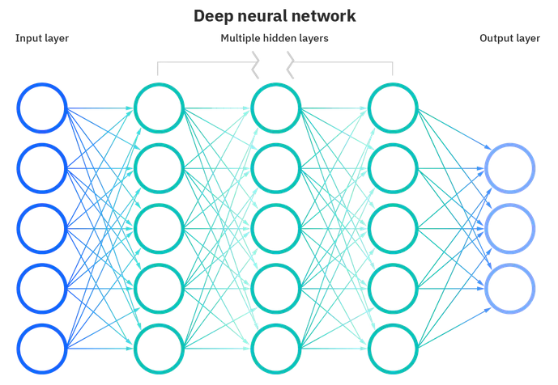
What is Neural Network?
Artificial Neural Networks were designed to mimic the human brain.
Each node is connected to other nodes and they each have weights and thresholds.
If the threshold is surpassed, then the node activates and sends its data to the next nodes.
Notes:
Iterations or Epochs are used to train the neural network.

Slide 5
Data Engineering - Dataset
6 Datasets recorded and generated by UAV above major roads
70-140mb file sizes
Dataset 4 has ~30 million data points
Example: UAV 1 Dataset
The length of the study road section is 427 meters, east-west direction, including two-way ten Lane East end and two-way six Lane West end. There are two roads merging in the east-west direction, and two roads diverging in the west-east direction, and the number of lanes changes intensively.
This video was captured by a UAV at 310m altitude for 4 minutes and 15 seconds.
This data provides the precise vehicle position coordinates with a time accuracy of 0.1s, and contains the information of each vehicle’s speed, acceleration, spacing, time distance, lane, etc.
Notes:
Unmanned Aerial Vehicle.

Slide 6
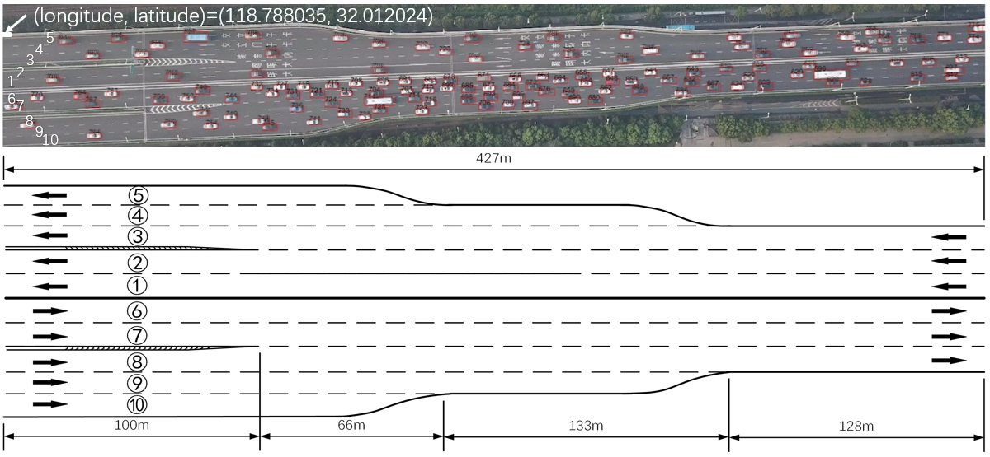
Data Engineering - Dataset (cont.)

Slide 7
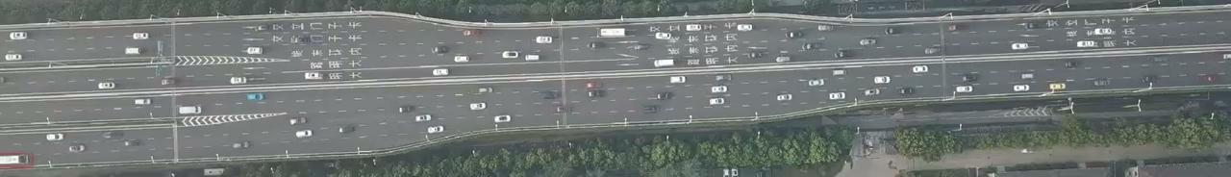
Data Engineering - Dataset (cont.)

Slide 8
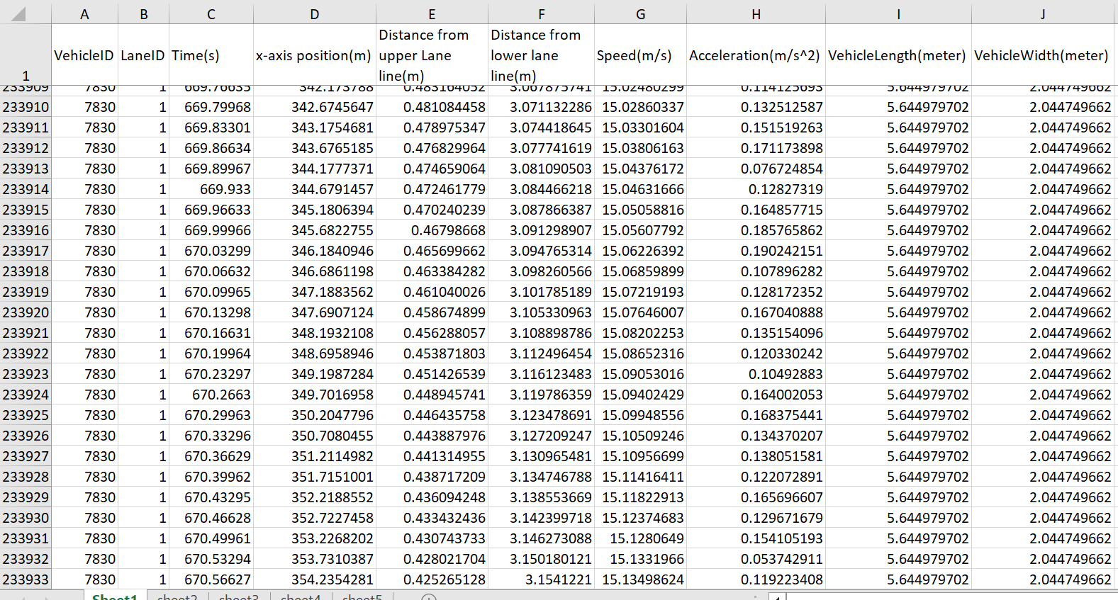
Data Engineering - Dataset (cont.)

Slide 9
Data Engineering - Taskset
Continuation of prior data cleaning procedure.
Additional features discovered that needed to be processed.
- Y-Axis determination methods: Universal, Local
- Local is more efficient for neural network. Delegate local Y-Axis to vehicle/UAV object detection for translation.
Forward feeding neural network for comparison and testing.
Notes:
Unmanned Aerial Vehicle.

Slide 10
Data Engineering - Log
Notes:
Unmanned Aerial Vehicle.

Slide 11
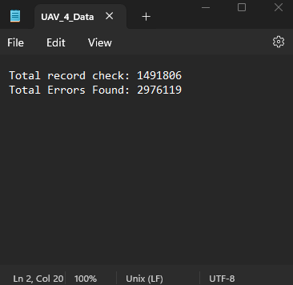
Data Engineering - Log
Notes:
Unmanned Aerial Vehicle.

Slide 12
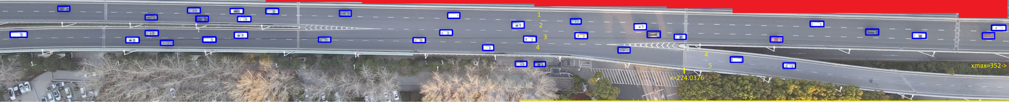
Data Engineering - UAV drone object detection
Notes:
Unmanned Aerial Vehicle.

Slide 13
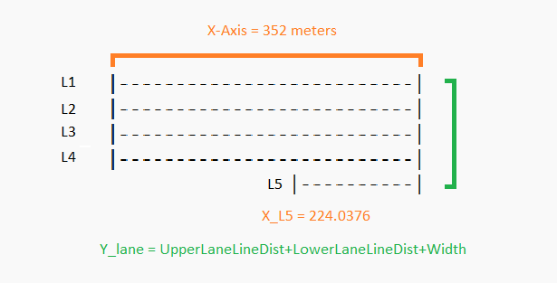
Data Engineering - Neural Net vision (Local Y-axis)
Notes:
Unmanned Aerial Vehicle.

Slide 14
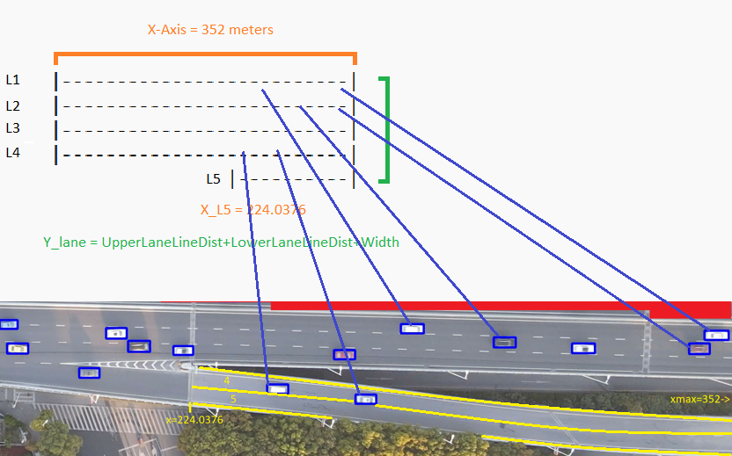
Data Engineering - Abstract to Object mapping
Notes:
Unmanned Aerial Vehicle.

Slide 15
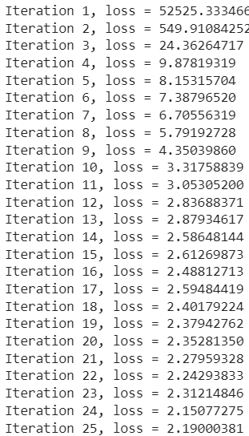
Data Engineering - Forward feeding NN test (clean data)
Notes:
Unmanned Aerial Vehicle.

Slide 16
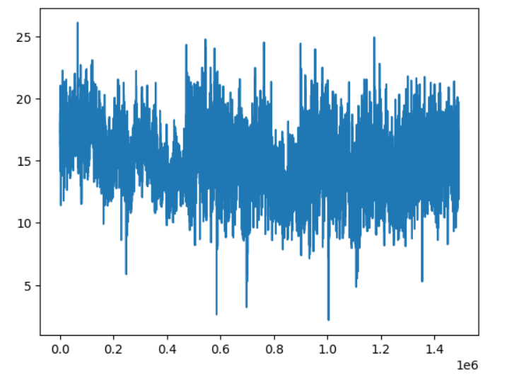
Data Engineering - Cleaned Data

Slide 17
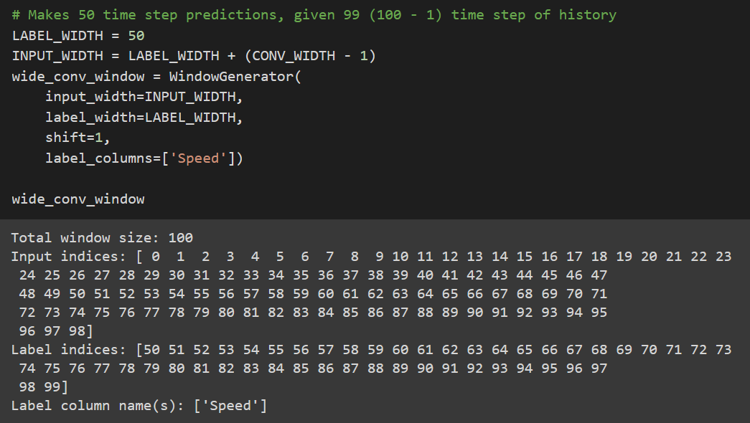
Neural Network - Data Windowing

Slide 18
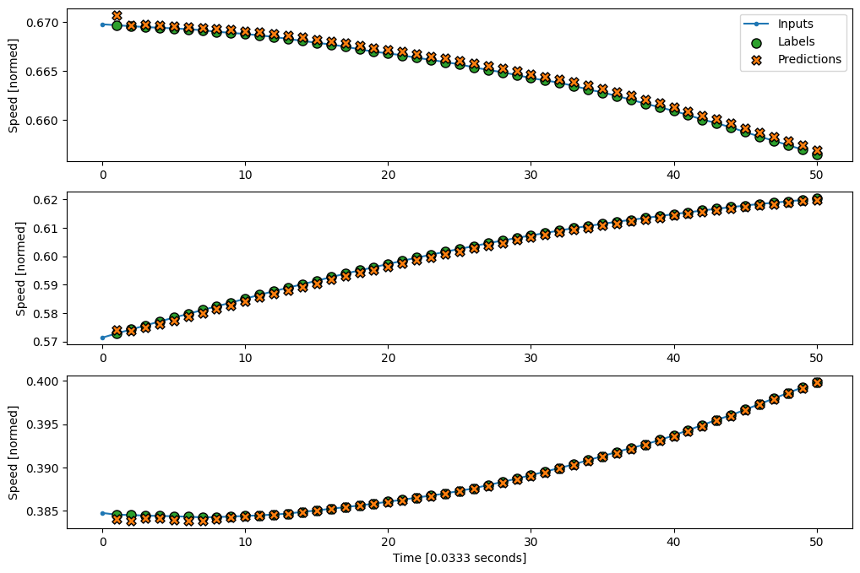
Neural Network - Recurrent Neural Network

Slide 19
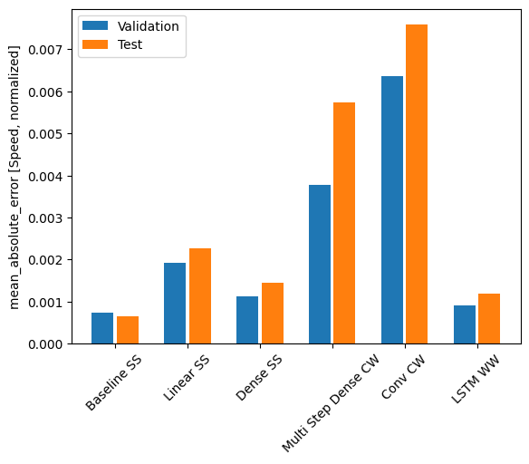
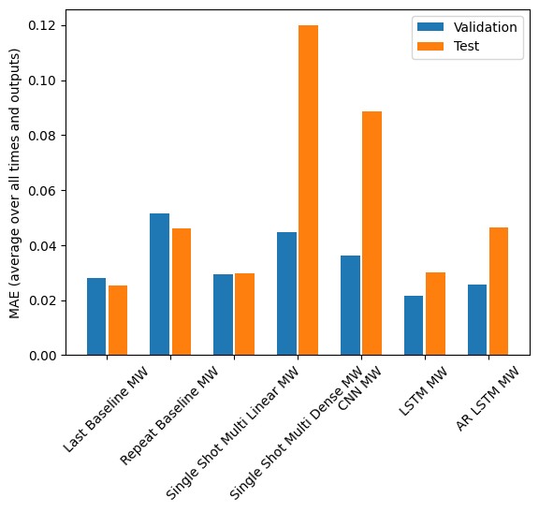
Neural Network - Performance Comparison

Slide 20
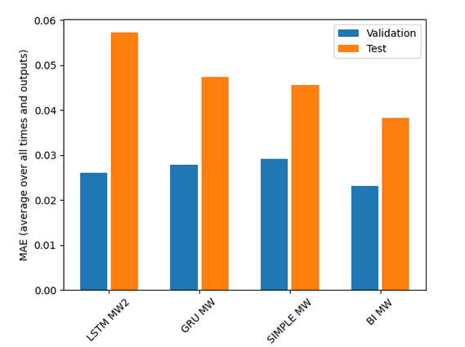
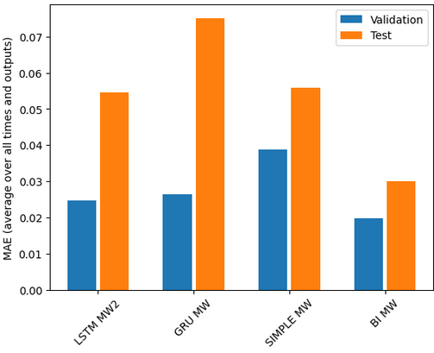
Neural Networks - 4 More Models

Slide 21
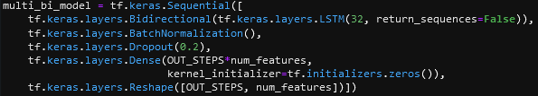
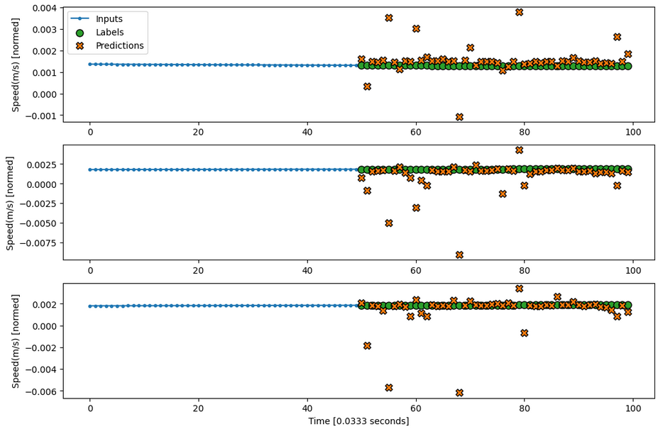
Neural Networks - Bidirectional Model Setup

Slide 22
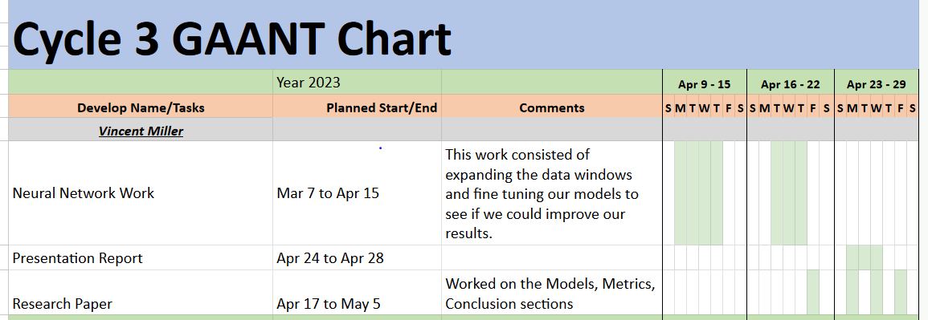
Management Plan

Slide 23
Lessons Learned
We needed to understand Neural Networks in order to read the research papers about this topic. Upon reading the first paper, it’s very confusing without any understanding. We had to backtrack slightly and review how neural networks are built, the type of neural networks, and then we practiced with tutorials.
We learned to ensure we are all using similar versions of Python and the associated libraries. We had issues with the TensorFlow library not working correctly and the issue was it has not been updated to work beyond Python 3.10, when some of us had Python 3.11 installed.
We learned what is involved in data comprehension. We had to understand the data we were looking at before we were able to do any work. We figured out what the features were for the dataset which makes it easier to apply a neural network.
We learned what was involved in data cleaning. We believe because the drone’s object tracking sometimes flickers on a vehicle that would lead to erroneous values like -5.11036E-11. (This value is seen multiple times)

Slide 24
Lessons Learned
We learned to normalize our data. We needed to understand that neural networks work in the floating point range of 0.0 to 1.0, and we must normalize or scale our data to fit in that range.
We overestimated how much data was needed when running the models and predictions. We used a small amount of data and it led to many of the models being not as accurate as they should have been. The models started to predict more accurately as we fed it much more data.
We had to learn to deal with computation complexity. Our largest dataset has ~30 million data points and this leads to models needing 4+ hours to train and Google Collab has a 90 minute idle timer. Even purchasing Google Collab Pro for $10 for one month, and using Premium GPU, does not perform better than our personal computers.

